Slide 1
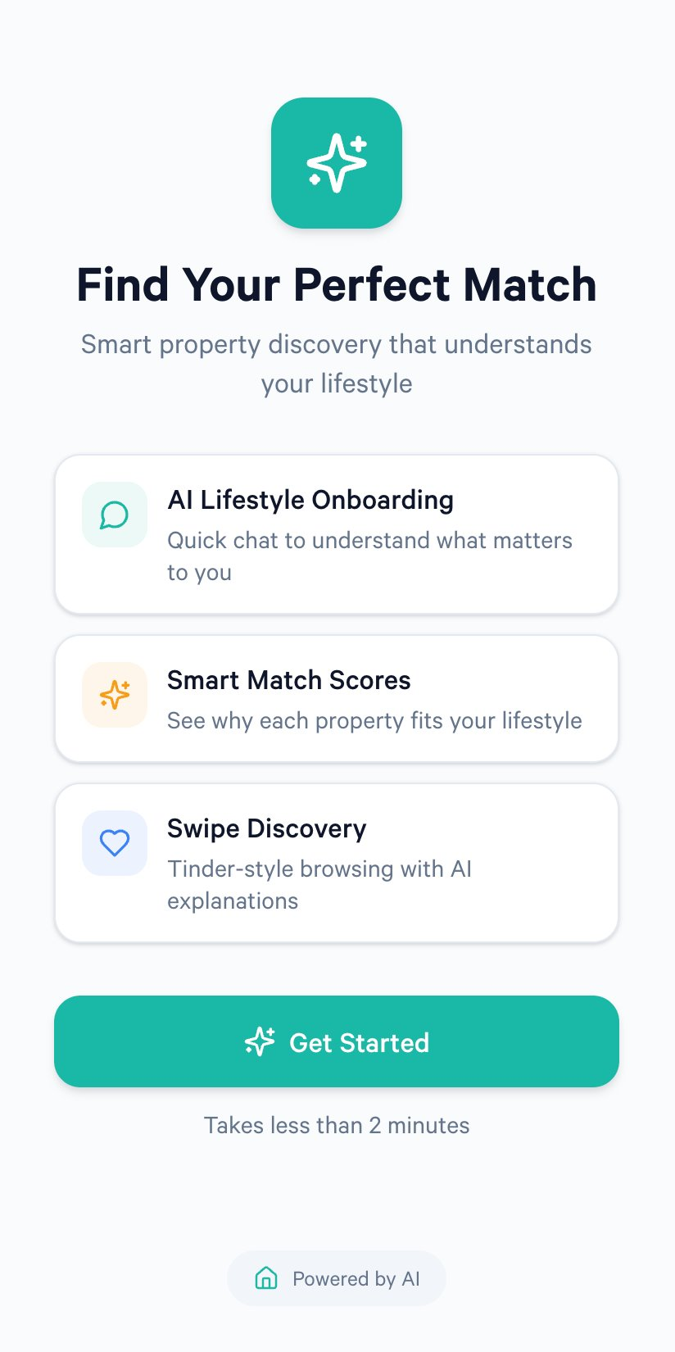
AI Property Matchmaker for brokers:
Intent-driven guidance for confident property recommendations to the customers.
Notes:
Image source: Microsoft 365 content library

Slide 2
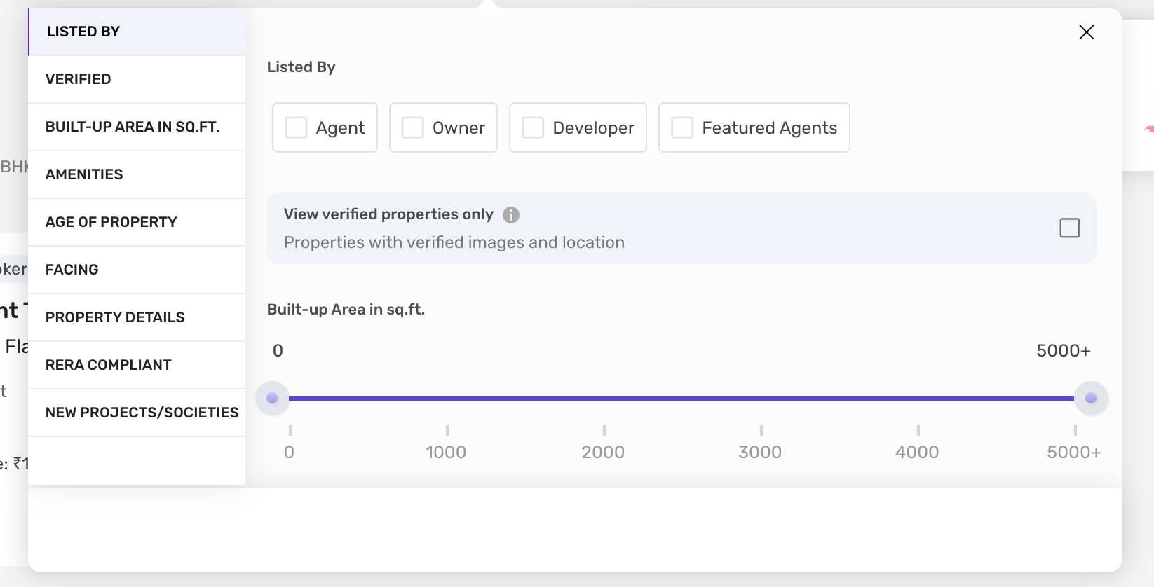
The Core Problem
Broker Bias in Property Recommendations
1. Commission-Driven Decisions
Brokers often prefer listings with higher payouts
Customer needs take a back seat
2. Limited Knowledge
Brokers rely on their own limited neighborhood expertise
Many new or better‑fit properties stay undiscovered
3. Human Shortcuts
Assumptions about customer budgets, family needs, or lifestyle
Leads to stereotyping and mismatched recommendations
4. Inventory Pressure
Developers push brokers to sell specific properties
Customers receive filtered, not optimal, choices
Notes:
Modern real estate platforms offer an abundance of filters, yet users still struggle to make confident property decisions. The fundamental problem is not a lack of data, but a lack of understanding of human intent. Current systems are designed to filter properties based on static attributes such as price, size, amenities, and location, but they completely ignore the emotional, strategic, and future-oriented objectives that drive real-world purchases. Buyers often think in terms of long-term versus short-term investment, resale potential, financial risk, sustainability, and lifestyle fit, none of which can be expressed clearly through existing filter mechanisms. As a result, users are forced to mentally evaluate hundreds of listings, compare trade-offs manually, and rely on incomplete advice from brokers or online reviews. This leads to decision fatigue, anxiety, and frequent regret after purchase. For example, two properties with the same price and size may differ drastically in future appreciation, rental stability, or livability, but traditional platforms treat them as equals. Additionally, different users interpret the same filters differently; a “good location” for an investor is not the same as a “good location” for a family or a retiree. The absence of intent-aware intelligence means platforms cannot personalize recommendations meaningfully. This gap is especially critical in high-stakes markets like real estate, where decisions involve large financial commitments and long-term consequences. Without guidance on risk, future growth, or purpose alignment, users are left navigating one of the most important decisions of their lives with tools designed for simple product searches. This mismatch between user intent and platform capability creates a clear opportunity for an AI-driven, purpose-aware solution.
Image source: Microsoft 365 content library

Slide 3
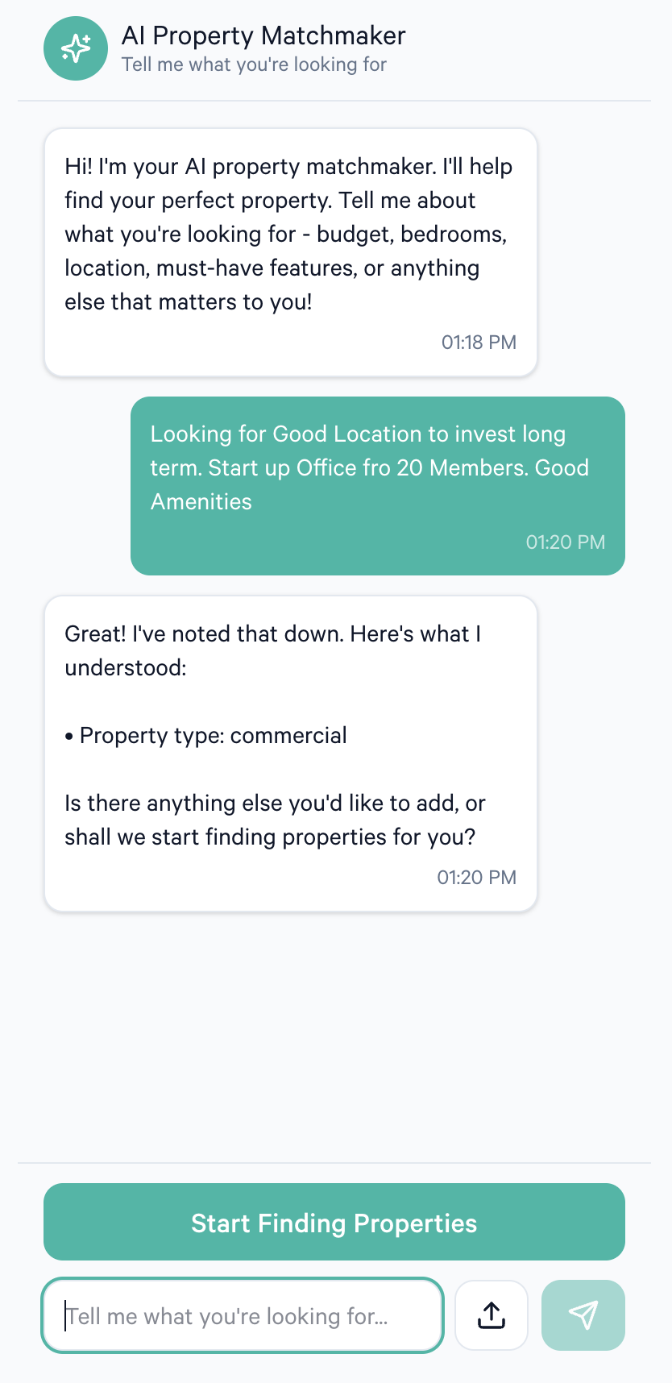
The Solution
From Filters to Intent Matching
Filters miss real motivations
Price, beds, and radius don’t capture emotion, risk tolerance, future plans, or personal values behind a life decision.
Start with intent, not checkboxes
The matchmaker learns whether someone wants long-term stability, short-term appreciation, self-use comfort, or a sustainable lifestyle.
Explainable recommendations
AI converts goals into structured signals, returning a short-ranked set with clear reasoning (e.g., low-risk stability vs. high-growth upside).
Notes:
Property discovery today is dominated by mechanical filters such as price range, number of bedrooms, square footage, and location radius. While these parameters are useful, they fail to capture the deeper motivations behind why people actually buy property. Buyers are not simply searching for buildings; they are making long-term life and financial decisions shaped by emotion, risk tolerance, future plans, and personal values. The AI Property Matchmaker reframes property search from a transactional activity into an intent-driven decision-making experience. Instead of forcing users to manually combine dozens of filters and still feel uncertain, the platform begins by understanding the user as a person. It captures whether the buyer is looking for a long-term investment, a short-term appreciation opportunity, a stable self-use home, or a sustainable lifestyle choice. It also considers emotional comfort, future family plans, and financial mindset. Using artificial intelligence, the system translates these abstract goals into structured intelligence that can be matched against real-world property data. The outcome is not a long list of similar-looking listings, but a small set of highly relevant properties ranked by compatibility and explained with clear reasoning. For example, a user focused on low-risk, long-term value is shown properties with stable appreciation history, strong rental demand, and infrastructure-backed locations, while a high-risk investor sees emerging areas with higher growth potential. In essence, the AI Property Matchmaker acts as a trusted property advisor that understands intent, reduces confusion, and builds confidence in decision-making. Rather than helping users search faster, it helps them choose better, aligning property decisions with life goals instead of just checkboxes.
Image source: Microsoft 365 content library

Slide 4
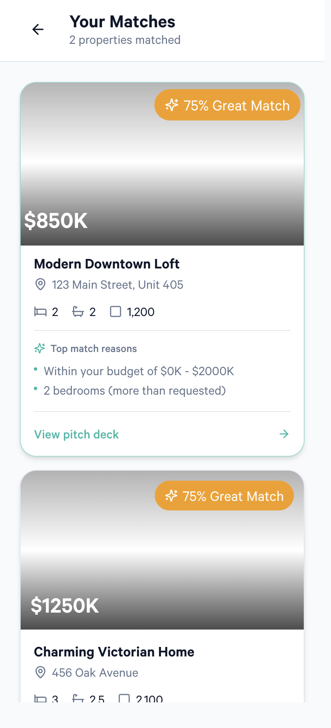
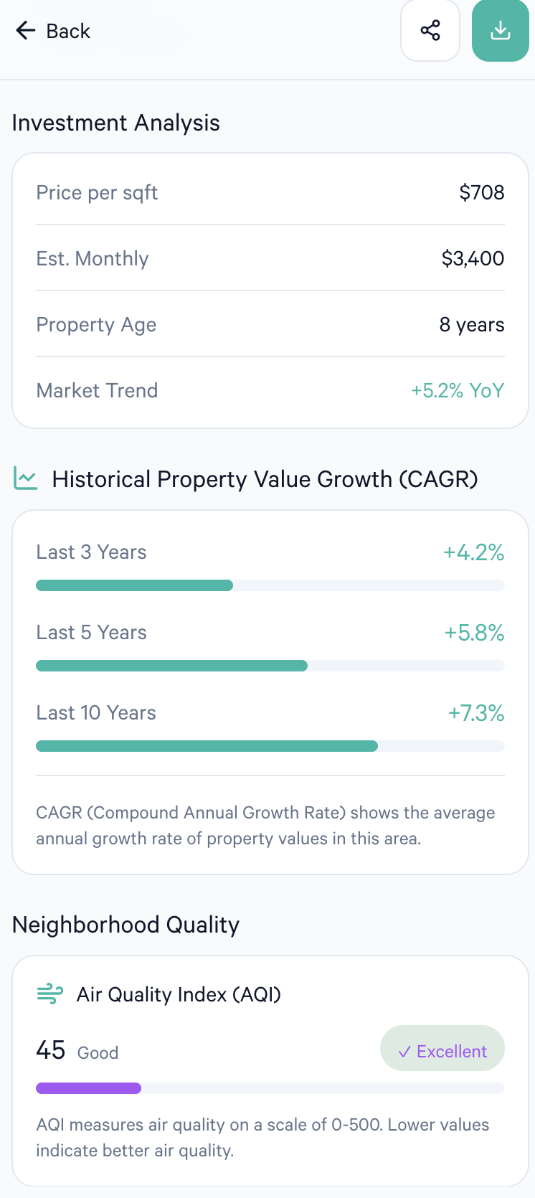
AI-Driven Solution
AI Score Evaluation Framework
1️⃣ Natural Language House Needs → AI Match
User just talks:
“I want a bright 2BHK near tech hubs, but quiet. Pet friendly. Not too expensive.”
AI converts this into structured preferences + priorities.
Tech: LLM, embeddings, minimal rules.
2️⃣ Lifestyle Compatibility Index (LCI)
3️⃣ AI Negotiator for Compromise
4️⃣ Smart Q&A: AI Asks Instead of You
5️⃣ Image/Landmark Reasoning + Insights
6️⃣ Map Intelligence Layer
7️⃣ Conversational Compare Mode
8️⃣ Fraud/Red Flag Detection
Notes:
At the heart of the AI Property Matchmaker is a multi-dimensional scoring framework designed to rank listings based on intent alignment rather than surface-level similarity. Each property is evaluated across several purpose-driven dimensions that reflect how people actually make decisions. These dimensions include investment horizon alignment, resale potential, financial risk exposure, self-sustainability, lifestyle compatibility, and future growth outlook of the location. The AI assigns dynamic weights to each dimension based on the user’s stated goals. For example, a long-term investor with low risk tolerance will see higher weighting for stability, infrastructure maturity, and resale liquidity, while a high-risk investor may see growth potential and price volatility weighted more heavily. The scoring model produces a unified compatibility score on a 0 to 100 scale, making it easy for users to compare options at a glance. Importantly, the system does not operate as a black box. Alongside the score, the AI provides reasoning statements that explain which factors contributed most to the ranking and where trade-offs exist. This transparency helps users understand not just which property is recommended, but why it is recommended for their specific intent. Over time, the framework can learn from user feedback and outcomes, continuously refining weightings and improving recommendation accuracy. This approach turns raw property data into actionable intelligence, enabling smarter, faster, and more confident decisions.
Image source: Microsoft 365 content library

Slide 5
Benefit
For Customers
✅ Highly personalized property options
✅ Faster decision-making
✅ Transparent reasoning behind matches
For Brokers
✅ Improved conversions
✅ Less manual work
✅ Elevated professionalism
For Developers
✅ Better-qualified customer targeting
✅ Fair visibility across projects
Notes:
At the heart of the AI Property Matchmaker is a multi-dimensional scoring framework designed to rank listings based on intent alignment rather than surface-level similarity. Each property is evaluated across several purpose-driven dimensions that reflect how people actually make decisions. These dimensions include investment horizon alignment, resale potential, financial risk exposure, self-sustainability, lifestyle compatibility, and future growth outlook of the location. The AI assigns dynamic weights to each dimension based on the user’s stated goals. For example, a long-term investor with low risk tolerance will see higher weighting for stability, infrastructure maturity, and resale liquidity, while a high-risk investor may see growth potential and price volatility weighted more heavily. The scoring model produces a unified compatibility score on a 0 to 100 scale, making it easy for users to compare options at a glance. Importantly, the system does not operate as a black box. Alongside the score, the AI provides reasoning statements that explain which factors contributed most to the ranking and where trade-offs exist. This transparency helps users understand not just which property is recommended, but why it is recommended for their specific intent. Over time, the framework can learn from user feedback and outcomes, continuously refining weightings and improving recommendation accuracy. This approach turns raw property data into actionable intelligence, enabling smarter, faster, and more confident decisions.
Image source: Microsoft 365 content library

Slide 6

Product & Growth Potential
Business Scope & Monetization
B2C premium advisory
Free basic matching with paid upgrades: investment analysis, risk/return views, and personalized consultations.
B2B licensing + intelligence layer
License the matching engine as an API to portals, builders, and brokerages to lift engagement and conversions.
Insights + partners
Monetize anonymized intent analytics and add referral revenue via banks, insurers, and legal-service integrations.
Notes:
The business potential of the AI Property Matchmaker extends across multiple real estate value chains. In the B2C space, the platform can operate as a premium property advisory service, offering free basic matching and paid advanced insights such as detailed investment analysis and personalized consultations. In the B2B space, the AI matching engine can be licensed as an API to existing real estate portals, builders, and brokerage firms, enhancing their recommendation capabilities and user engagement. Developers and institutional investors can use the intelligence layer to understand buyer intent trends and optimize inventory positioning. Additionally, anonymized market insights derived from aggregated intent data can be monetized through analytics offerings, helping stakeholders understand demand patterns and risk sentiment across regions. Strategic partnerships with banks, insurers, and legal service providers can further expand revenue through referral and integration models. Because the solution improves decision quality rather than just discovery, it positions itself as a high-value intelligence layer rather than a commodity listing platform, enabling sustainable and scalable revenue models.
Image source: Microsoft 365 content library

